Slide 1
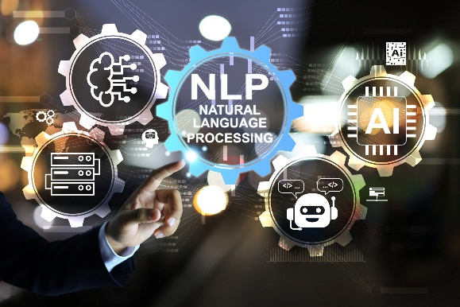

Dr. Muzamil Ahmed (Assistant Professor) Namal University Mianwali
Natural Language Processing
Text Representation
Bag-of-Words and TF-IDF, Baseline Models

Slide 2

Lesson from Quran

Slide 3

Lecture Outline
Text Representation
Types of Text Representation
Count Based and Dense Representations
Bag-of-Words Representation
Problem with Raw Word Counts
TF-IDF
Cosine Similarity – TF-IDF
Baseline Model
Summary

Slide 4
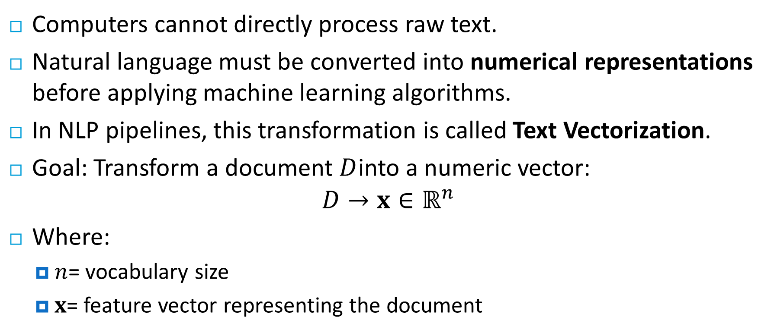
Motivation: Why Do We Need Text Representation?
Computers cannot directly process raw text.
Natural language must be converted into numerical representations before applying machine learning algorithms.
In NLP pipelines, this transformation is called Text Vectorization.
Goal: Transform a document $D$into a numeric vector:
$$D→x∈ℝ^{n}$$
Where:
$n$= vocabulary size
$x$= feature vector representing the document

Slide 5
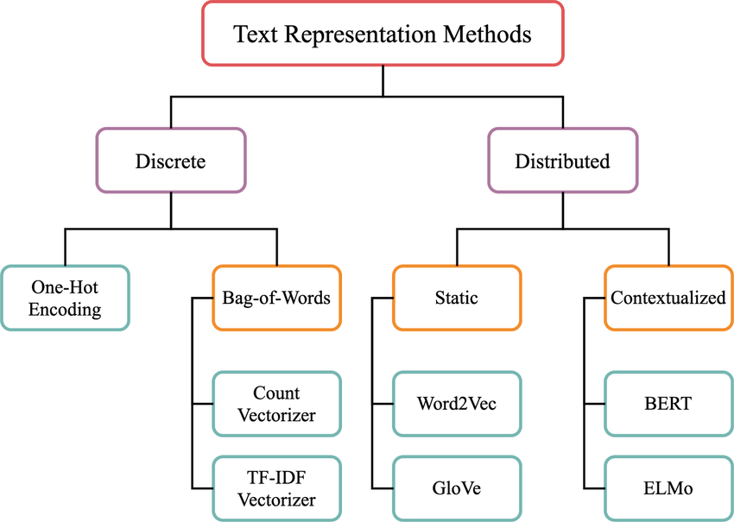
Types of Text Representations
Text representations can be divided into two major categories:
Count-Based Representations
Dense Distributed Representations
Basic Idea: Language meaning emerges from patterns of word co-occurrence.

Slide 6
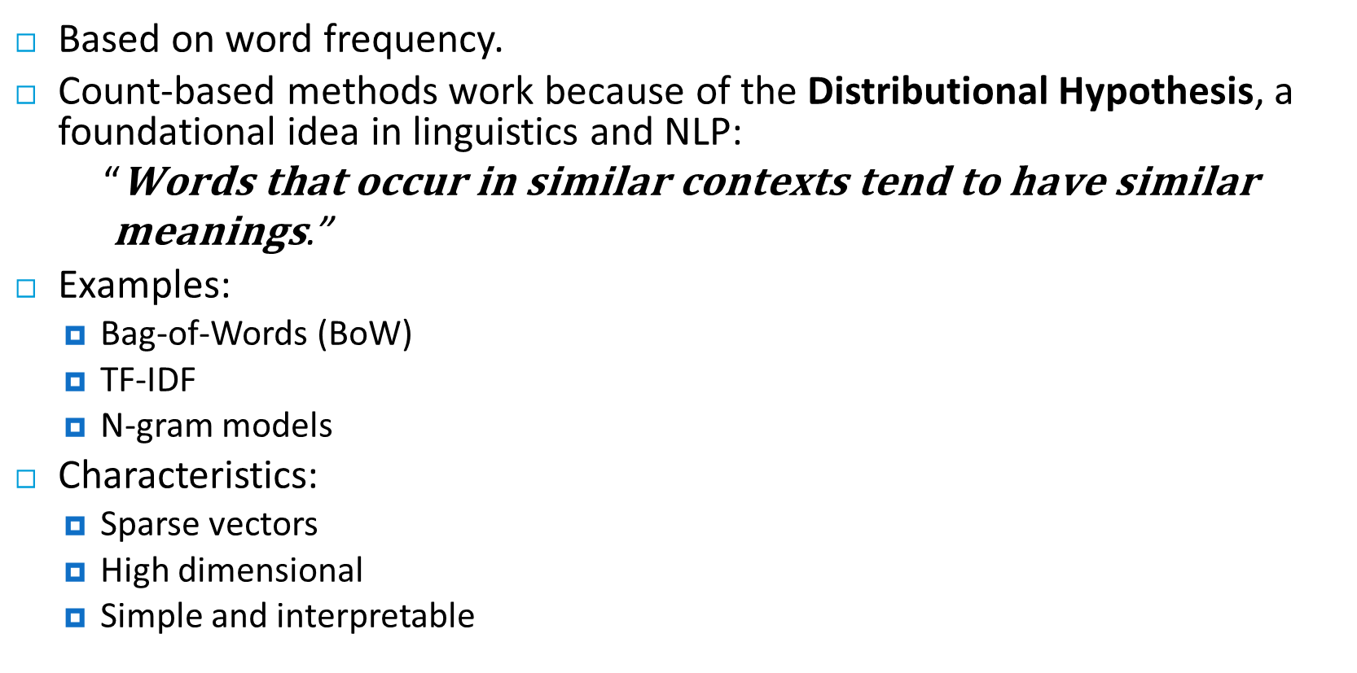
Count-Based Representations
Based on word frequency.
Count-based methods work because of the Distributional Hypothesis, a foundational idea in linguistics and NLP:
$$\text{“}\text{Words} \text{that} \text{occur} \text{in} \text{similar} \text{contexts} \text{tend} \text{to} \text{have} \text{similar} \text{meanings}\text{.}\text{”}$$
Examples:
Bag-of-Words (BoW)
TF-IDF
N-gram models
Characteristics:
Sparse vectors
High dimensional
Simple and interpretable

Slide 7
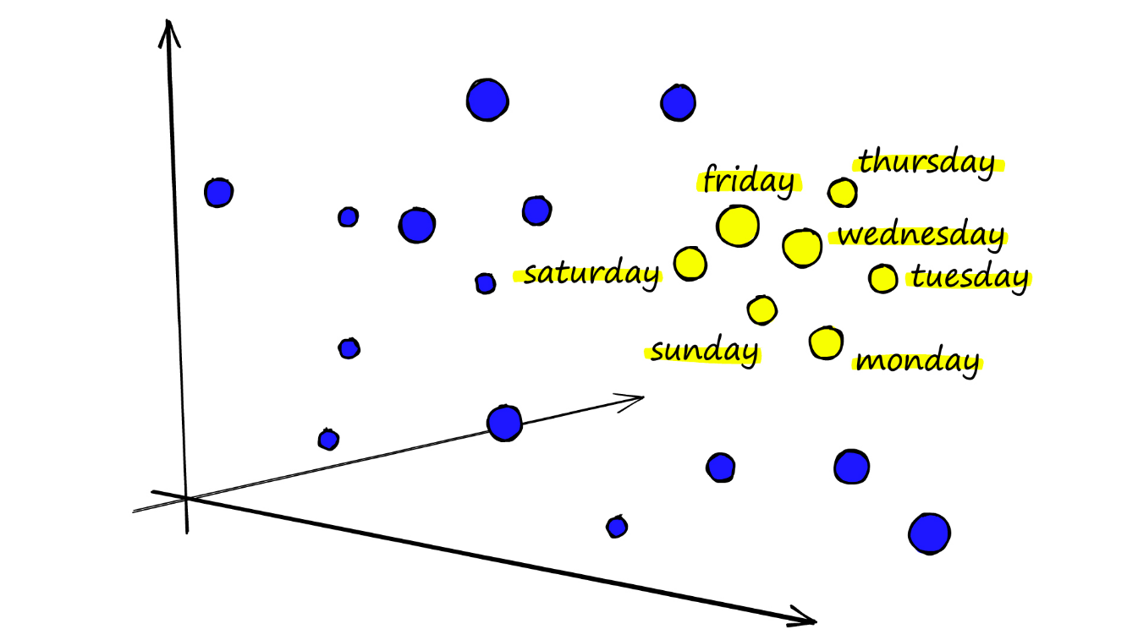
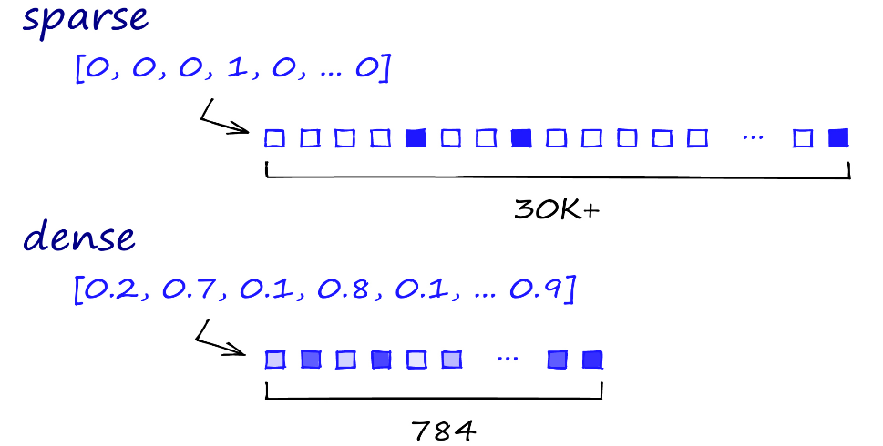
Dense Distributed Representations
Based on neural embeddings.
Examples:
Word2Vec
GloVe
FastText
Transformer embeddings
Characteristics:
Dense vectors
Capture semantic meaning
Lower dimensional

Slide 8
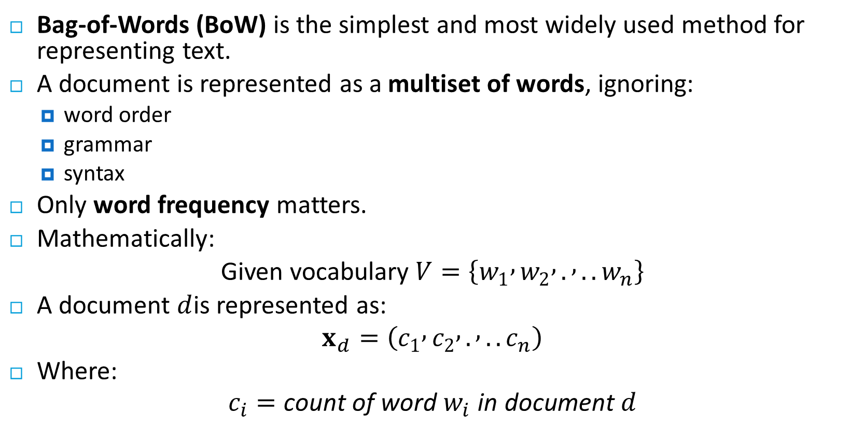
Bag-of-Words Representation
Bag-of-Words (BoW) is the simplest and most widely used method for representing text.
A document is represented as a multiset of words, ignoring:
word order
grammar
syntax
Only word frequency matters.
Mathematically:
Given vocabulary $V=\left\{w_{1} , w_{2} , . , ..w_{n}\right\}$
A document $d$is represented as:
$$x_{d}=\left(c_{1} , c_{2} , . , ..c_{n}\right)$$
Where:
$$c_{i}=\text{count} \text{of} \text{word} w_{i} \text{in} \text{document} d$$

Slide 9
Bag-of-Words Representation
Each document or query is treated as a “bag” of words or terms. Word sequence is not considered.
Given a collection of documents D, let V = {t₁, t₂, ..., t_{|V|}} be the set of distinctive words/terms in the collection. V is called the vocabulary.
A weight w_{ij} > 0 is associated with each term t_{i} of a document d_{j} ∈ D. For a term that does not appear in document d_{j}, w_{ij} = 0.
d_{j} = (w_{1j}, w_{2j}, ..., w_{|V|j}),

Slide 10
Bag-of-Words Representation
Example Corpus:
D1: I love NLP
D2: I love machine learning
D3: NLP is interesting
Vocabulary: V={I,love,NLP,machine,learning,is,interesting}
Document | I | love | NLP | machine | learning | is | interesting
D1 | 1 | 1 | 1 | 0 | 0 | 0 | 0
D2 | 1 | 1 | 0 | 1 | 1 | 0 | 0
D3 | 0 | 0 | 1 | 0 | 0 | 1 | 1

Slide 11
Problem with Raw Word Counts
Raw frequency counts create bias toward common words.
Example corpus:
the cat sat on the mat
the dog sat on the floor
Word "the" appears frequently but carries little semantic information.
Thus we need a weighting scheme that:
penalizes common words
emphasizes informative words

Slide 12
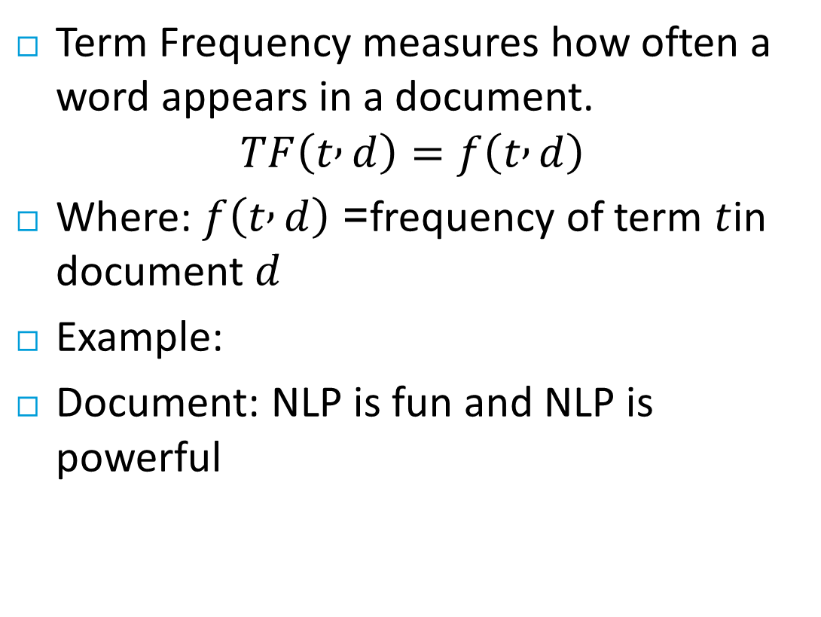
Term Frequency
Term Frequency measures how often a word appears in a document.
$$TF\left(t , d\right)=f\left(t , d\right)$$
Where: $f\left(t , d\right)$= frequency of term $t$in document $d$
Example:
Document: NLP is fun and NLP is powerful
word | count
NLP | 2
is | 2
fun | 1
powerful | 1

Slide 13
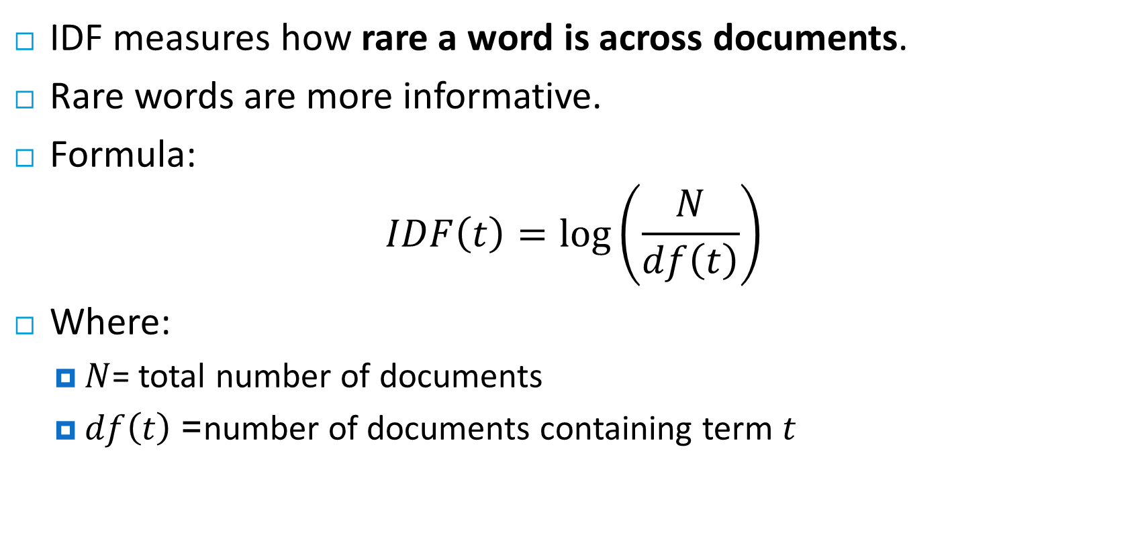
Inverse Document Frequency (IDF)
IDF measures how rare a word is across documents.
Rare words are more informative.
Formula:
$$IDF\left(t\right)=\log\left(\frac{N}{df\left(t\right)}\right)$$
Where:
$N$= total number of documents
$df\left(t\right)$= number of documents containing term $t$

Slide 14
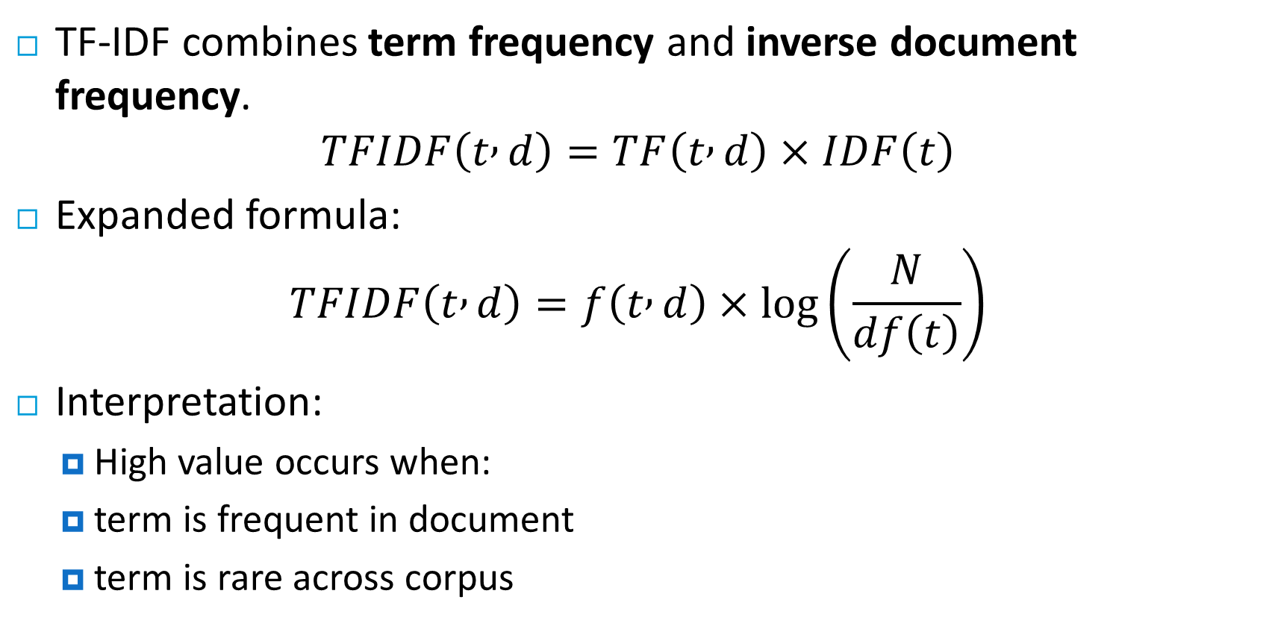
TF-IDF Weight
TF-IDF combines term frequency and inverse document frequency.
$$TFIDF\left(t , d\right)=TF\left(t , d\right)×IDF\left(t\right)$$
Expanded formula:
$$TFIDF\left(t , d\right)=f\left(t , d\right)×\log\left(\frac{N}{df\left(t\right)}\right)$$
Interpretation:
High value occurs when:
term is frequent in document
term is rare across corpus

Slide 15
Example
D1: "Shipment of gold damaged in a fire" D2: "Delivery of silver arrived in a silver truck" D3: "Shipment of gold arrived in a truck”
query : "gold silver truck“

Slide 16
Terms
Term Frequency (tf)
No of times a term occurred in a document
Document Frequency (df)
No of documents in which a term occurred.
Inverse Document Frequency
IDF = log(D/d_{i})

Slide 17
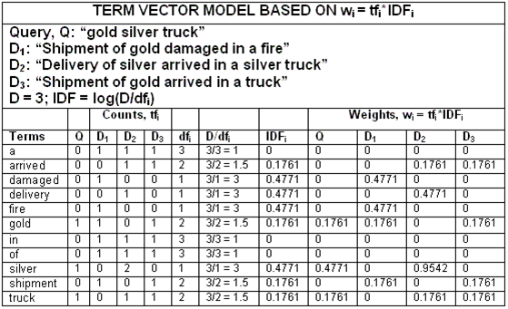
Term Frequency (tf)
No of times a term occurred in a document
Document Frequency (df)
No of documents in which a term occurred.
Inverse Document Frequency
IDF = log(D/d_{i})

Slide 18
Document to document similarity
Query q is represented in the same way or slightly differently.
Relevance of d_{i} to q: Compare the similarity of query q and document d_{i}.
Cosine similarity (the cosine of the angle between the two vectors)

Slide 19
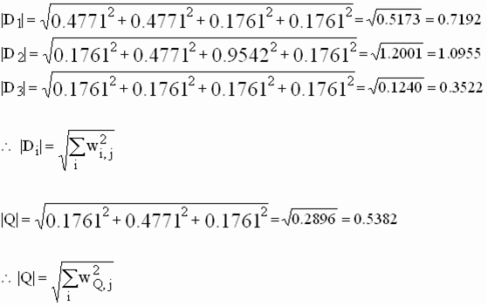
Cosine Similarity

Slide 20
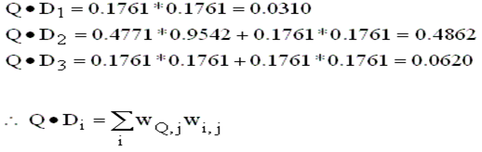
Cosine Similarity

Slide 21
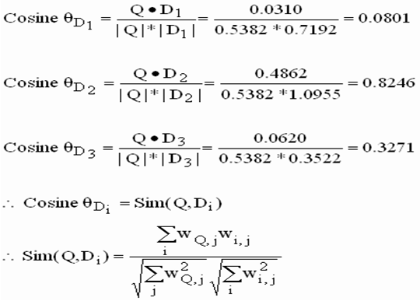
Cosine Similarity

Slide 22
Ranking
Rank 1: Doc 2 = 0.8246
Rank 2: Doc 3 = 0.3271
Rank 3: Doc 1 = 0.0801

Slide 23
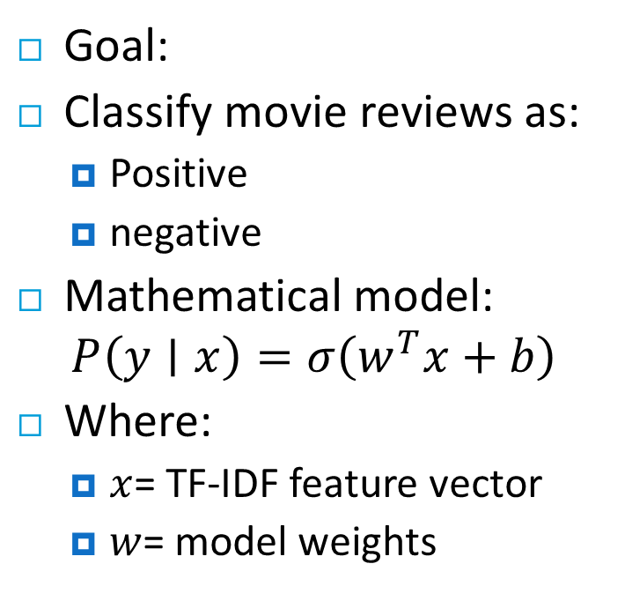
Baseline Model: Text Classification
Reviews
Tokenization
TF-IDF vectorization
Machine Learning Model
Prediction
Cleaning
Goal:
Classify movie reviews as:
Positive
negative
Mathematical model:
$$P\left(y∣x\right)=σ\left(w^{T}x+b\right)$$
Where:
$x$= TF-IDF feature vector
$w$= model weights
Notes:
Linear Combination: $w^{T}x+b$
$w$= model weights
Learned during training
Each word gets a weight (importance for prediction)
$w^{T}x$:
Dot product between weights and input vector
Computes a score for the review
$b$= bias term
Adjusts the score\
Sigmoid Function: $σ\left(⋅\right)$
$σ$= Sigmoid Function
It converts the score into a probability:
Output is always between 0 and 1

Slide 24
Why Baselines Are Important
Baselines provide:
1. Reference performance
TF-IDF + Logistic Regression → 85% accuracy BERT model → 86%
Improvement is small → model complexity not justified.
2. Debugging tool
If baseline works better than deep model:
data problem
training problem
feature problem

Slide 25
Summary
Key concepts covered:
Bag-of-Words
Count-based representation
Ignores word order
Simple but effective
TF-IDF
Penalizes common words
Highlights informative words
Baseline Models
Provide performance benchmarks
Often built with TF-IDF + classical ML

Slide 26

Thanks

